Slide 1
Austin Housing EDA
By: Greyson, Thi, and Jon

Slide 2
Project Overview/Agenda/etc. What to expect?
Objective
Data
Sources, Cleaning, Duplicates, Outliers, Missing Data
Analysis
Questions Answered and Actionable Insights
Limitations and Future Work
Q&A

Slide 3
Objective
Conduct an in-depth review of the Austin Housing Market data and determine what variables impact price, sales frequency, timing for selling versus buying, and other factors that play a role in the housing market.
Inspiration: there are plenty of analysis on home price changes and predicting prices, but what else is there?
List out original questions in the Project Proposal ?
What are different trends in the housing market?
How has the frequency of sales been affected by year? Have they increased or decreased?
What type of houses are being purchased? (single,
family, condo, multifamily)
Does the market favor investors/buyers or sellers?

Slide 4
Data and Analysis
Sources
Census, Google Maps API, Kaggle
Cleaning
Outliers
(speak to this or list them out and support with Visual Aid)
Show counts by home type, speak to bathroom and parking spaces outliers?
Missing Data
Data for 2021 homes sales was limited in this data set
(show counts by year visual aid?)
Summarize the focus of the data set that we worked from ?

Slide 5
Analysis
Overall we seek to answer the question of “What are different trends in the housing market?” (this is more of an overall question, answering the subsequent questions is essentially answering this question)
To answer that we look at a few key factors
What type of houses are being purchased? (single,family, condo, multifamily)
(Add visual for counts of each type?) Who has the bar chart wit the rotated names?

Slide 6
Analysis
How has the frequency of sales been affected by year? Have they increased or decreased?
It has increased, we can do a quick percentage calculation by year over year increase? Show a chart of the count of homes sold each year
Tie in the census data to compare it to population growth?
Utilize the monthly slide bar google maps and get class participation?
i.e. we need a volunteer to pick in which month/quater are the most homes sold?
Click on hyper link in the power point and determine winners, if any.

Slide 7
Analysis
Does the market favor investors/buyers or sellers?
Unable to answer with data set but our research implies that the month in which the house is listed/sold impacts the market

Slide 8
Analysis
What are different trends in the housing market?”
Square Footage
Location (can we support this with a visual?)
Time of the year (google map, do we need a regression model for this?)

Slide 9
Actionable Insights
For Investing/Buyers = Focus on Single Family homes for investing, buy during the winter months, ideally in Jan. Sell during the peak months in the late 2nd and 3rd quarters. ??
For current owners, do not list home December/Jan as sales are less likely to occur
Austin’s home sales are increasing at a lower rate than the population growth of the city?

Slide 10
Limitations and Future Work
Data
Did not include
list dates
initial sales price
length of time on the market
substantial data from 2021
total count of inventory
COVID impact could not be quantified
With unlimited time and budget, we would conduct a more thorough analysis on the market to identify the best possible location, time, etc.

Slide 11
Questions??

Slide 12
Items we need to address
Regressions to support our visual aids?
T-tests
A chart that shows the correlation results by variable
i.e. we ran a regression and correlation on several variables, square footage is strong compared to school rating or whether or not it had a view
Prediction versus actual ?
Robsut color schem on our visuals? Seaborn included yet?
Inspiration section?

Slide 13
Notes - requirements
Using Matplotlib to create a total of 6–8 visualizations of your data (ideally, at least two per ”question” you ask of your data) (regresssions, census info, and google maps heatmaps)
Saving PNG images of your visualizations to distribute to the class and instructional team, and for inclusion in your presentation.
Need these from each party, (utilize code for saving png plt.savefig(r'../output_data/plot_images/north_hem_lat_humidity.png', dpi = 100)
Screenshots from google maps (choose what types and what points we want to make with it.)
API info, (Optional) Using at least one API if you can find an API with data pertinent to your primary research questions. (census, Google Gmaps API?)
Creating a write-up summarizing your major findings. This should include a heading for each “question” you asked of your data and a short description of your findings and any relevant plots.

Slide 14
From lecture slides
You will also be responsible for preparing a formal, 10-minute presentation that covers:
Questions you found interesting and what motivated you to answer them
Where and how you found the data you used to answer these questions
The data exploration and cleanup process (accompanied by your Jupyter Notebook)
The analysis process (accompanied by your Jupyter Notebook)
Your conclusions, which should include a numerical summary and visualizations of that summary
The implications of your findings: What do your findings mean?

Slide 15
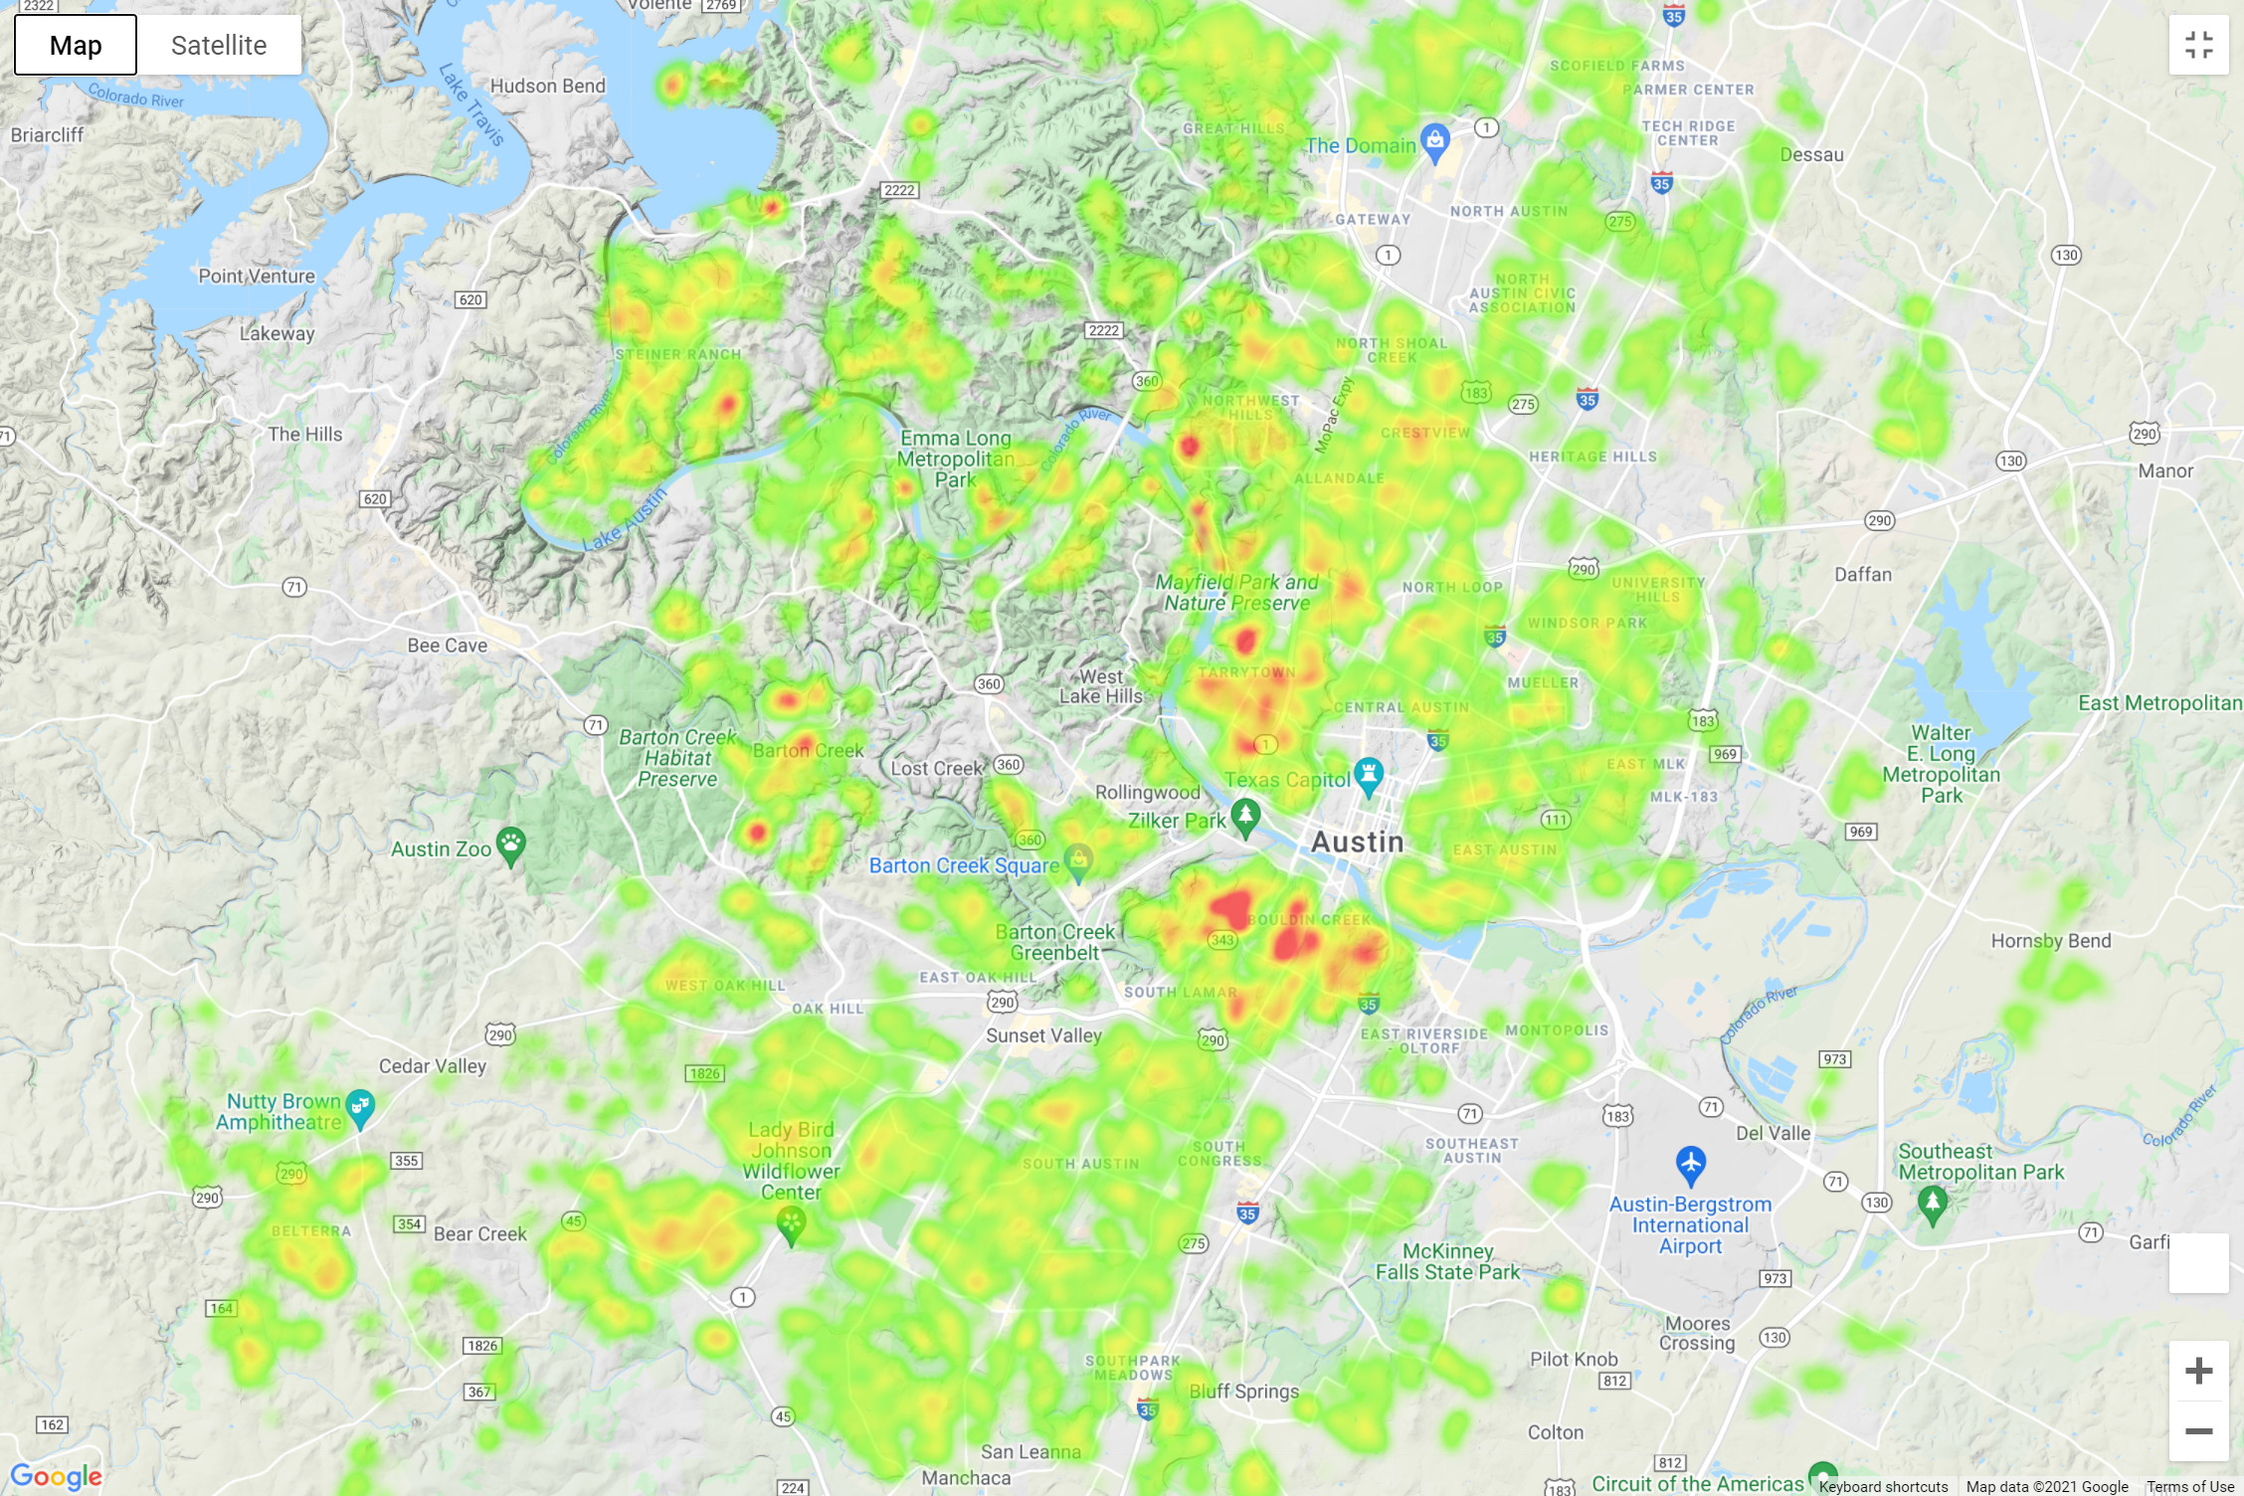
Heatmap by sales price
Including

Slide 16
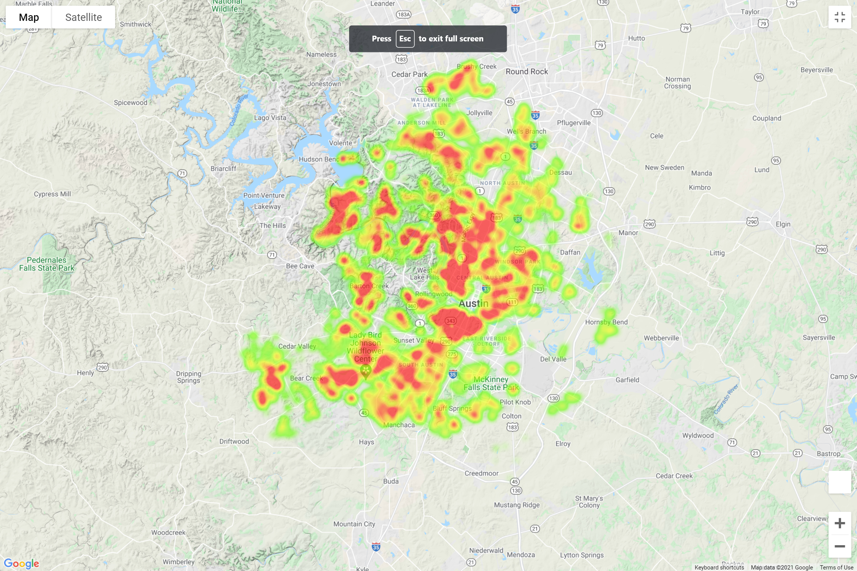
Heatmap by sales price
Singly Family Home

Slide 17
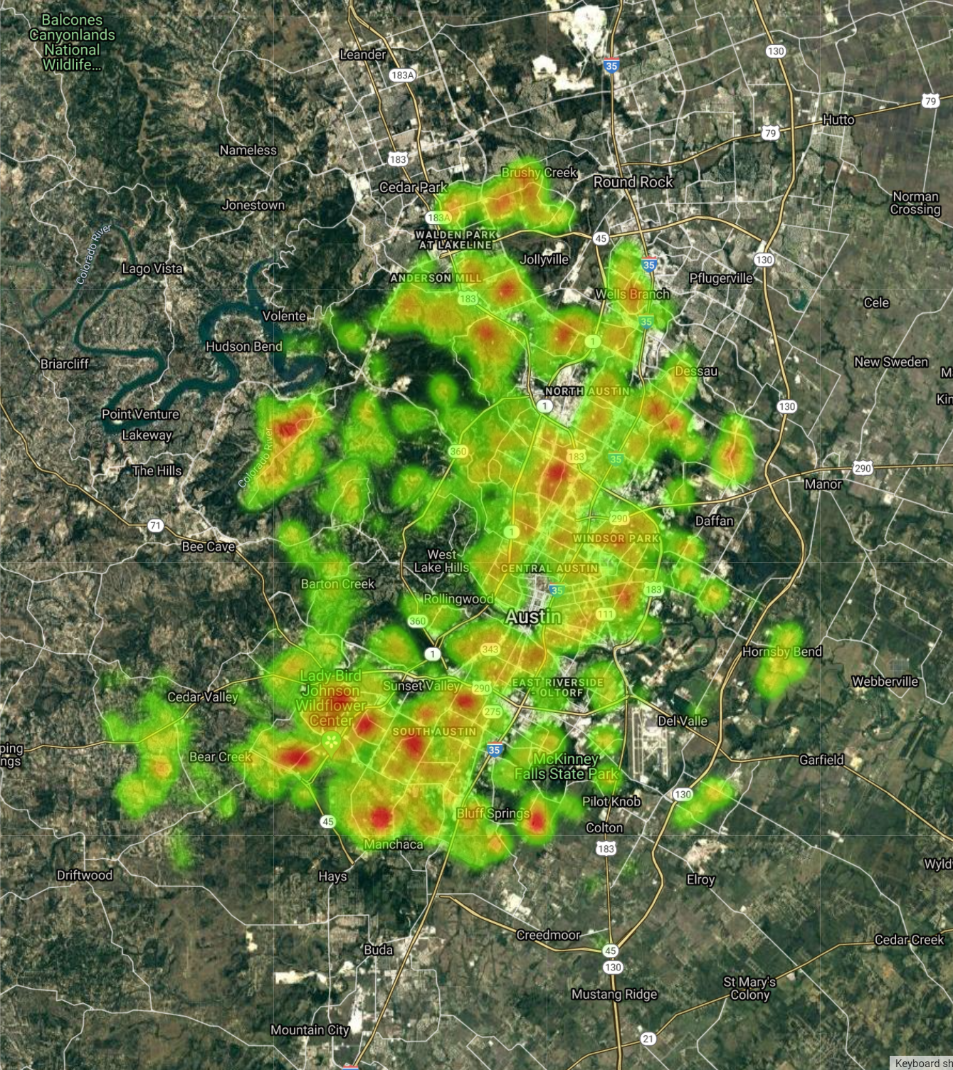
Heatmap by sales price
2018

Slide 18
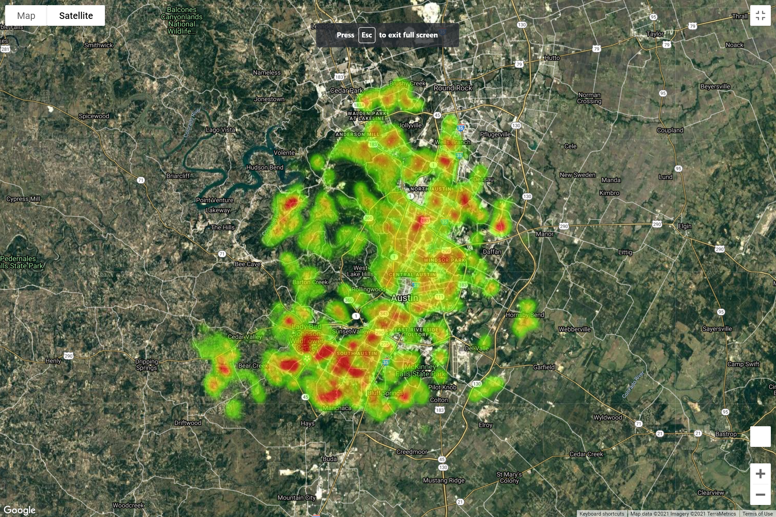
Heatmap by sales price
2019

Slide 19
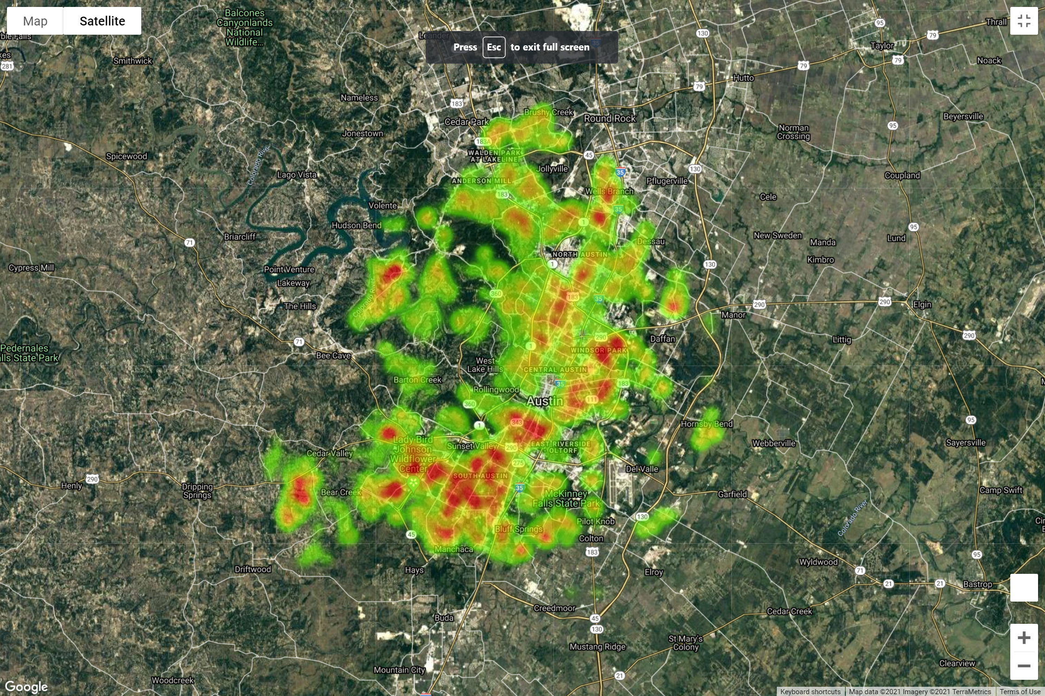
Heatmap by sales price
2020
Click to see who is correct
Notes:
Hyperlink will work if you have anaconda prompt open, if you have previously opened it and run the kernel it should work without having to do so.

Slide 20

2018 4118 home sales
2019 4992 home sales
2020 5053 home sales

